Slide 1

T99X171.00 comparison table of different FW CPU Loading
Cooper.Kung
2022.12.13

Slide 2
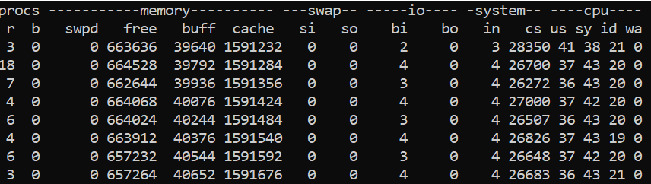
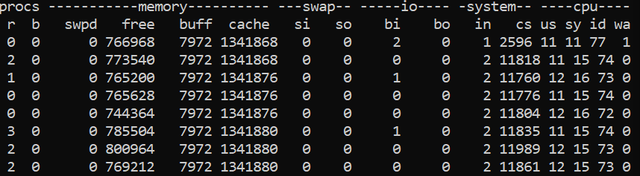
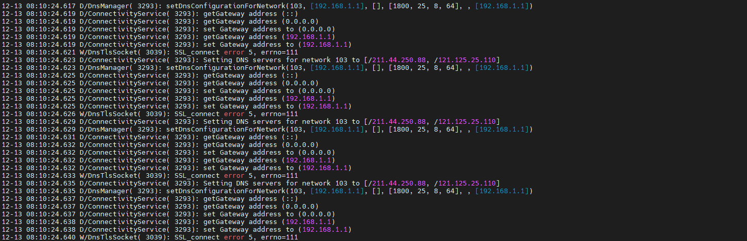
T99X171.00 comparison table of different FW CPU Loading
1.FW Version: 15.502.13(r13 DVT1) | 1.FW Version: 15.523.06(Remove Shield CAN)
2.Command: vmstat | 2.Command: vmstat
3.CPU Load = 100-id=80% | 3.CPU Load = 100-id=27%
4.Cause of high CPU loading: logcat will continue output error message, It will cause high load on system server
5. Summary: 15.502.13(r13 DVT) FW will logcat output error message continuously when Ethernet connected. It will also causes high CPU load and leads to poor thermal test results.

Slide 3


